Slide 1
Programming pradgism - Functional programming -
Composition function

Slide 2
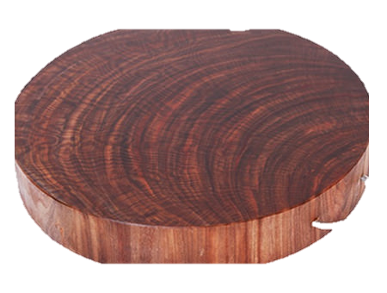
Intro
var thớt = cưa('khúc gỗ');
thớt = sấy(thớt);
thớt = bào(thớt);
thớt = khoan(thớt);
thớt = chà(thớt);
thớt = móc(thớt);
console.log(thớt);
=> khúc gỗ đã cưa đã sấy đã bào đã khoan đã chà đã gắn móc
Nguồn: https://kipalog.com/posts/Functional-Programming---Phan-2---Nhap-dao

Slide 3
Intro
var thớt = móc(chà(khoan(bào(sấy(cưa('khúc gỗ')))))); console.log(thớt);

Slide 4
1. Composition function
fn x = ceiling (negate (tan (cos (max 50 x))))
--->
fn = ceiling . negate . tan . cos . max 50

Slide 5
1. Composition function
ghci> map (\xs -> negate (sum (tail xs))) [[1..5],[3..6],[1..7]]
[-14,-15,-27]
--->
ghci> map (negate . sum . tail) [[1..5],[3..6],[1..7]]
[-14,-15,-27]

Slide 6
2. Excercise
Find sum of all squares less than 10000 of odd numbers?

Slide 7
2. Excercise
oddSquareSum :: Integer
oddSquareSum = sum (takeWhile (<10000) (filter odd (map (^2) [1..])))
Or:
oddSquareSum :: Integer
oddSquareSum = sum . takeWhile (<10000) . filter odd . map (^2) $ [1..]

Slide 8
2. Excercise
oddSquareSum :: Integer
oddSquareSum =
let oddSquares = filter odd $ map (^2) [1..]
belowLimit = takeWhile (<10000) oddSquares
in sum belowLimit

